Slide 1

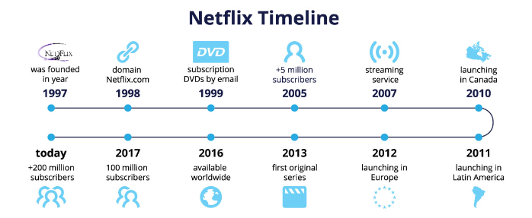

How Did they do it ?
It has been long road of trial and error , luck and perfect timing

Slide 2

The N represents connection and a never-ending stream of stories
Planning Desing and Data
1997
Registered by Reed Hastings and Marc Randolph as ‘Kibble’
1998
Netflix registered its domain Netflix.com
Total of 239,000 subscribers
1999
2001- 2007
unlimited content for just $19.95 and no return fee
Expanded library of 3100 titles
Netflix's video library expands to 3,100 titles
A total of 239,000 subscribers
Netflix hits one million subscribers
Introduce of Watch Now service first trial in Canada
Delivering directly to TVs, computers, and tablets
video library of just 900 titles.
Customer Satisfaction

Slide 3
PLANNING
https://tridenstechnology.com/netflix-subscribers-statistics/
In 2012 Europeans could use it – launching in Europe
In 2013 launched its first 3 original series: House of Cards, Hemlock Grove, and Orange is the New Black
In 2016 Netflix became available worldwide
In 2017 Netflix reached 100 million subscribers
Expand in other countries not just US

Slide 4
PLANNING
https://tridenstechnology.com/netflix-subscribers-statistics/
In 2021 Netflix hits 209 million subscribers in over 190 countries
Notable exceptions are North Korea, Syria, China, and Iran
More than 15,000 titles across all its international libraries
Introduces mobile games, allowing users to play games on Netflix.
Expand in other countries not just US

Slide 5
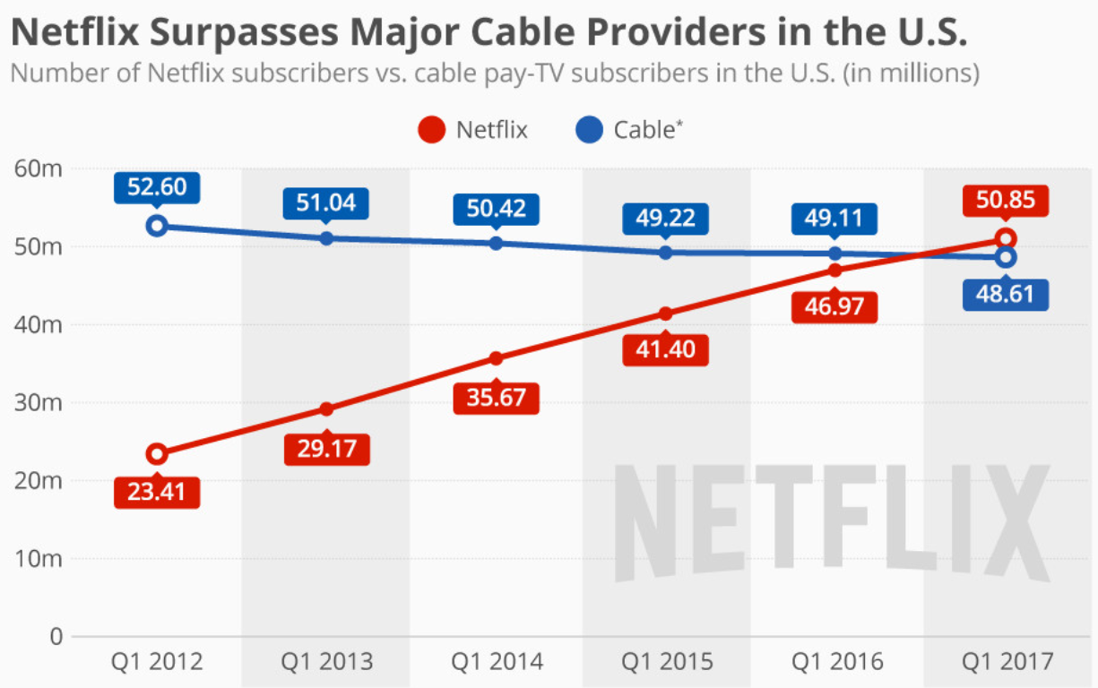
They always knew business could progress on online store

Slide 6
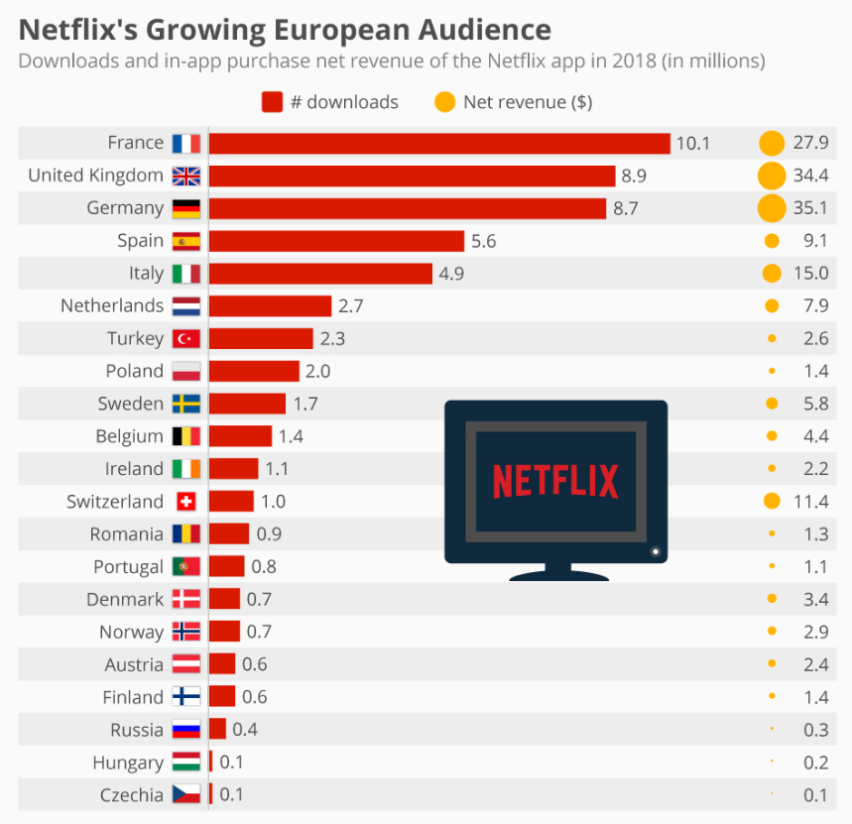
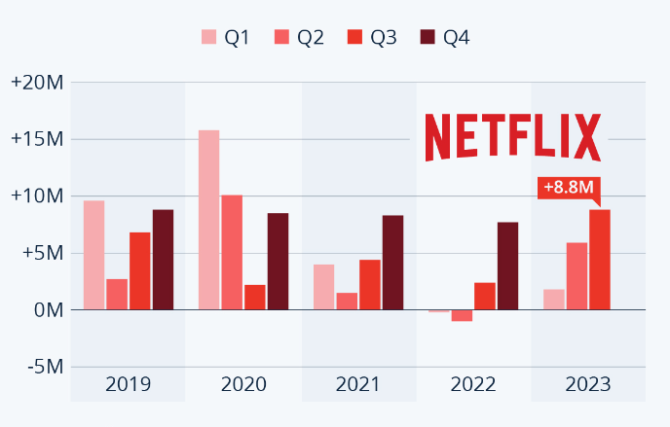
PLANNING
It was not always easy : consider downward trend post Covid

Slide 7
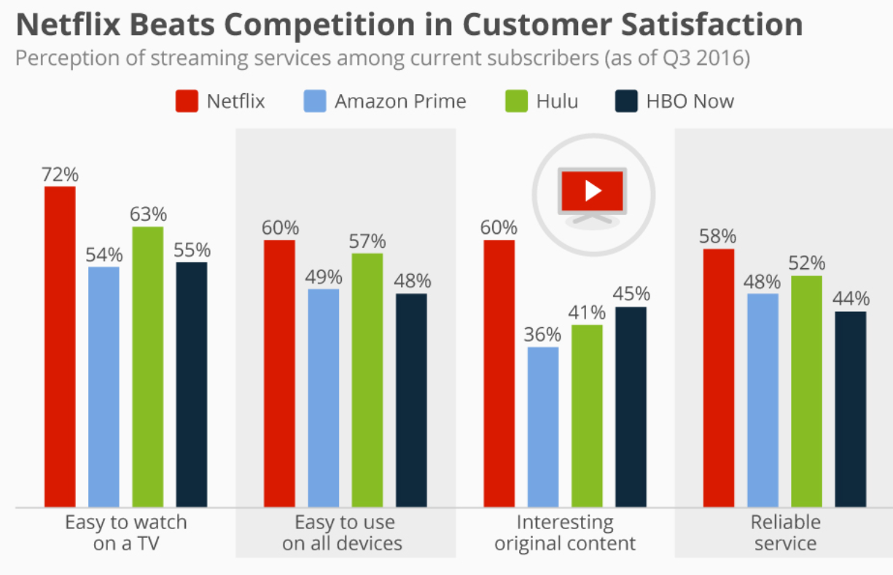
Ease of use, reliability and know your customers

Slide 8
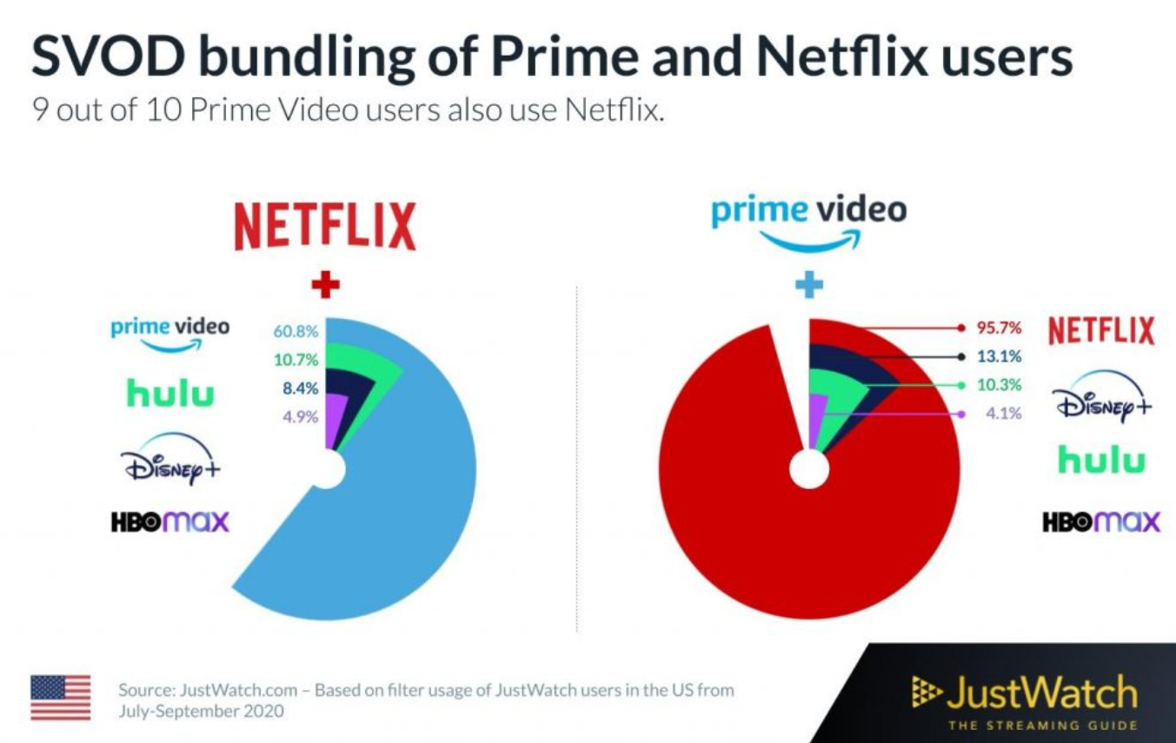
Learn from your competitors.

Slide 9
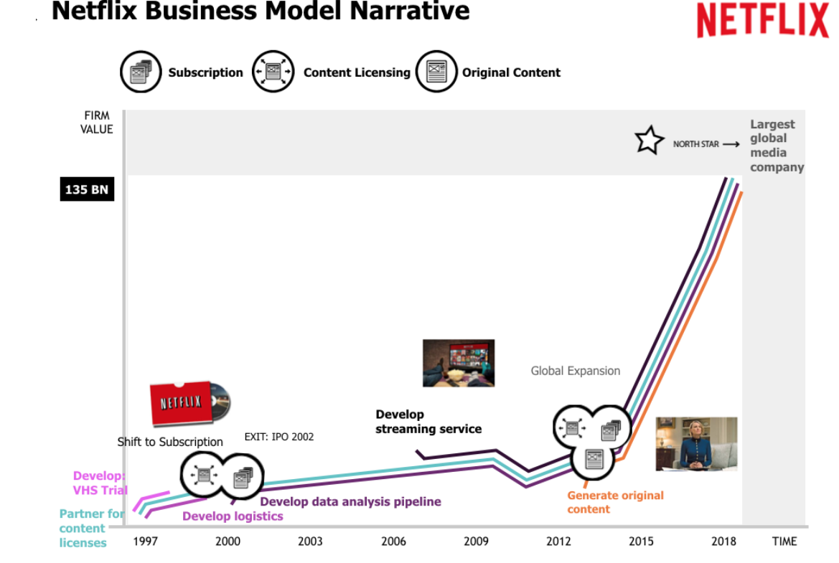
When did the interest in data begin ?
Learn from your competitors.

Slide 10
Key Factors
Always knew business could progress on online store
Customer Satisfaction.
Grow with Technology .
They always knew business could progress on online store
Ease of use, reliability and know your customers
Forefront of Innovation
Learn from your competitors. Know your Weakness

Slide 11
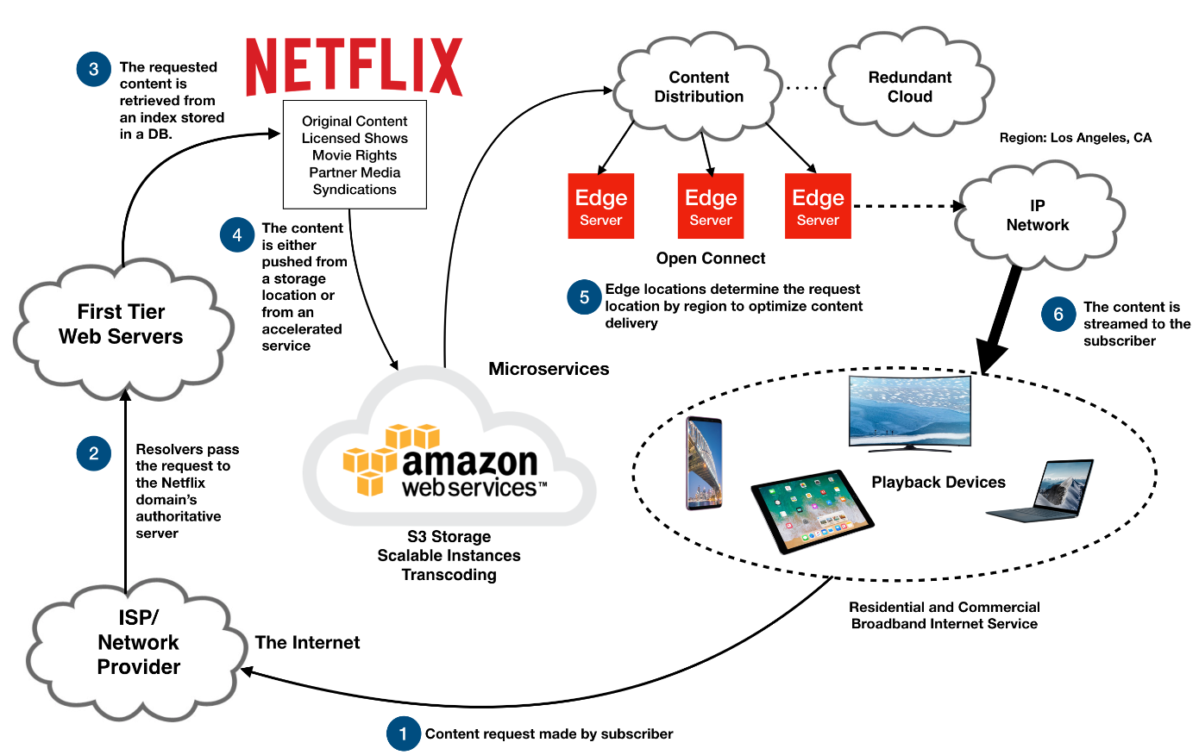
Netflix and its systems

Slide 12
Use of Deep Learning to improve Netflix Recommended systems
Value of Recommended System
Member Satisfaction and Unique customer experience
Adult 1 : On TV
Adult 2 : Mobile
Age 16 : On Tablet
Over 5 : On TV

Slide 13
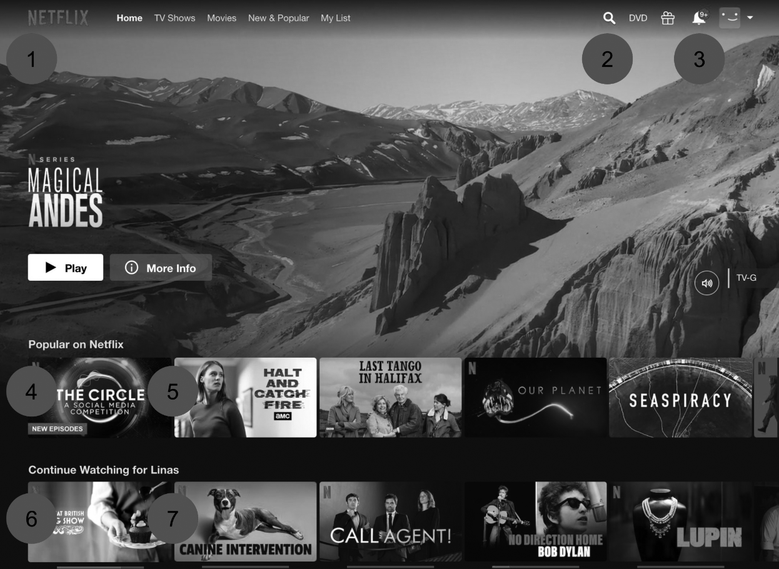
Different Algorithms used on Netflix Page
2.Searche engine
1. Choose first video to display
3. Message Notification
5. New Video
4. 6 Which row to present for personalised display
7. Continue watching

Slide 14






Bag of Items Approach
Play
Pause
Search
Click
Like
Just like what we shop in the market , Bag of item approach looks for user interaction on each session

Slide 15
Its not just the Deep learning models but it is also important to have supporting infrastructure or echo system where these models can perform well
Other Recommended models which perform well on recommended system are :
Neural Network
TensorFlow
Keras
PyTorch

Slide 16
References
Reporting and Sharing of Results : Cases Used
https://research.netflix.com
https://tidsskrift.dk/mediekultur/article/view/121223

